Slide 1
Complexity Analysis
&
Don’t You Remember! :D

Slide 2
Facebook Group
https://www.facebook.com/groups/pst.community.eg/

Slide 3
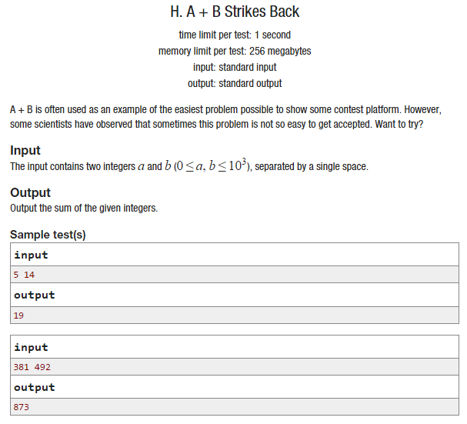
Problem Format
● Problem title
● Problem description
● Input specifications
● Output specifications
● Sample Input
● Sample Output

Slide 4

Online Judges

Slide 5
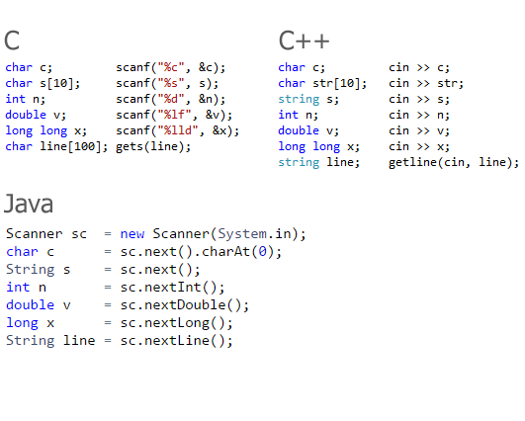
Input

Slide 6
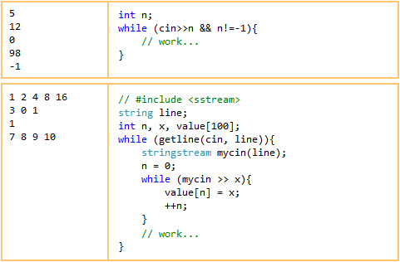
Input - Examples

Slide 7
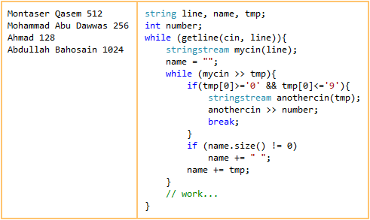
Input - Examples

Slide 8
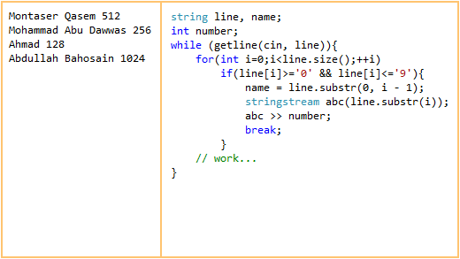
Input - Examples

Slide 9
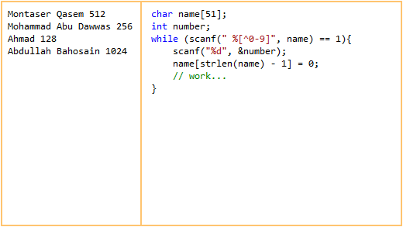
Input - Examples

Slide 10
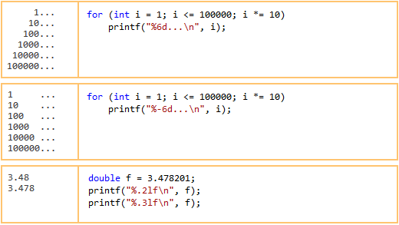
Output

Slide 11
Data Type Ranges
Data type | Size (byte) | Range
bool | 1 | True / False
char | 1 | -128 to 127
short | 2 | -32,768 to +32,767
int | 4 | -2,147,483,648 to +2,147,483,647
float | 4 | ±3.4x10e-38 to ±3.4x10e38
double | 8 | ±1.7x10e-308 to ±1.7x10e308
long long | 8 | -9.2e+18 to +9.2e+18

Slide 12

Double Vs. Float

Slide 13
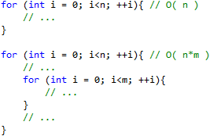
Complexity

Slide 14
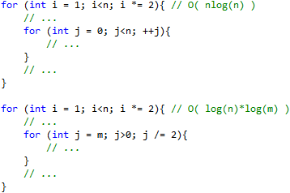
Complexity

Slide 15
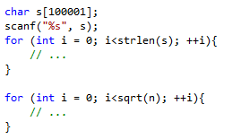
Complexity

Slide 16
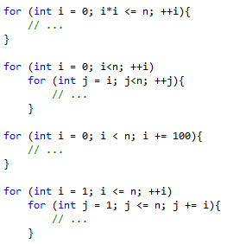
Complexity

Slide 17
Thank You!

